Slide 1
I400 – Application Development in Java
Lab 3

Slide 2
Today
Language Practice
Methods & Arrays

Slide 3
Language Practice
Today you’ll be practicing methods and arrays.
All problems (but not their solutions) are on the prelim slides.
Work at your group’s pace.

Slide 4
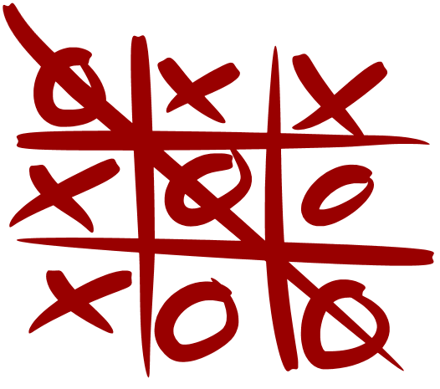
Tic Tac Toe
Today’s problem is the game of Tic-Tac-Toe.
If you aren’t familiar with this, please take a moment to read about it:
https://en.wikipedia.org/wiki/Tic-tac-toe

Slide 5
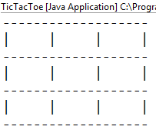
Tic Tac Toe pt 1 (Group Work)
Create the TicTacToe class, and define a 2-dimensional array of Strings to represent the board. Write a printBoard method to output the current board (starts with no symbols on it) and call this method from main.
HINT: Initialize the cells of your array to three spaces each.

Slide 6
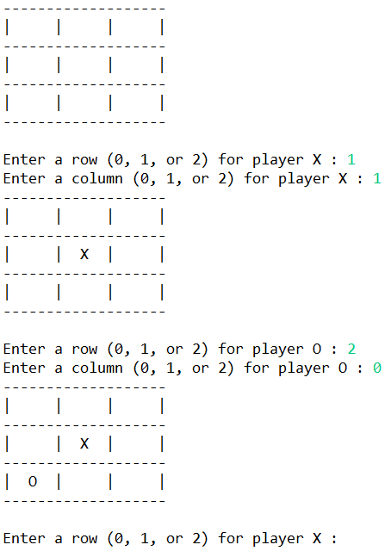
Tic Tac Toe pt 2 (Group Work)
Using a loop, take user input about where to place symbols for the two players (X and O).
Symbols should alternate.
Do not allow symbols to be placed in cells that already contain symbols.

Slide 7
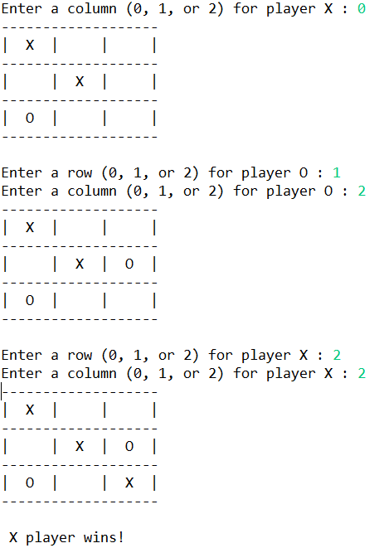
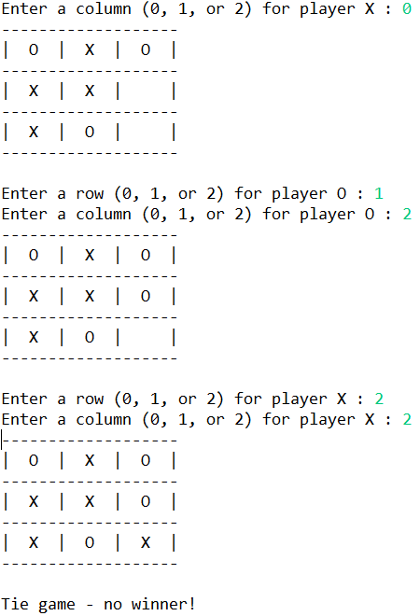
Tic Tac Toe pt 3 (Group Work)
Write the winCheck method, which checks for a player winning through placing three symbols in a row.
This can be by column, by diagonal, or by row.
HINT: If all symbols are placed and there’s no winner, it’s a tie!

Slide 8
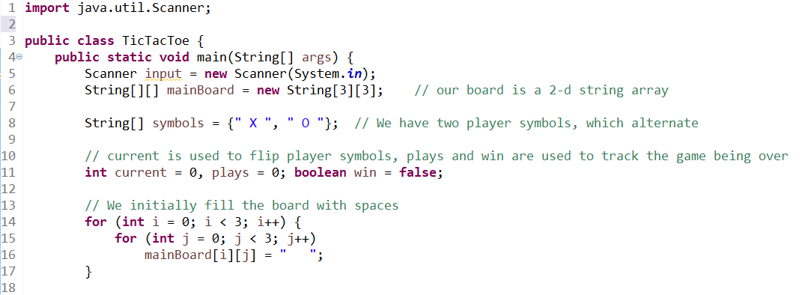
Tic Tac Toe (Solution pt 1)

Slide 9
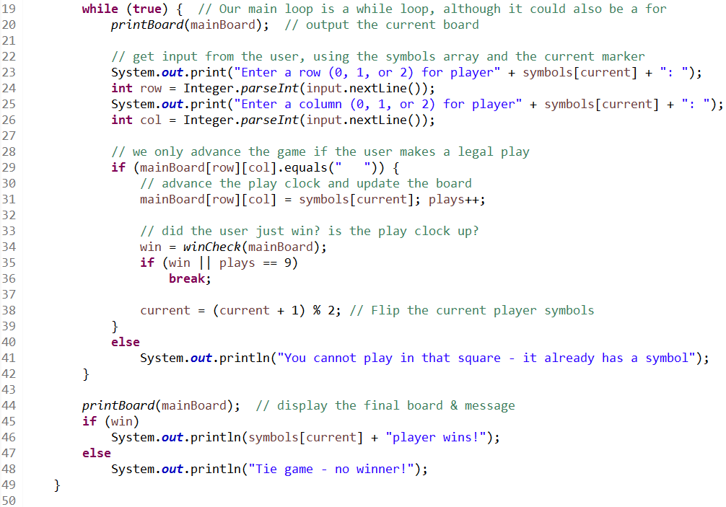
Tic Tac Toe (Solution pt 2)

Slide 10
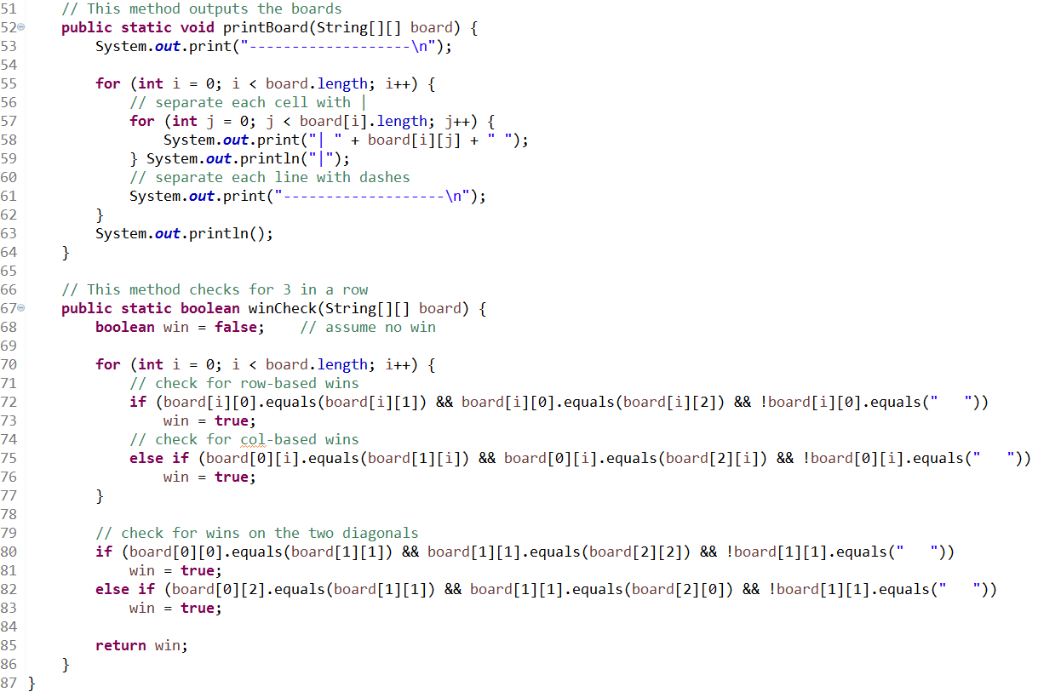
Tic Tac Toe (Solution pt 3)

Slide 11
Questions?

